Slide 1


Certified Tax
Professional Pathway
Personal Tax workshop
DAY 1
Last updated 25 Sept 2026 (incl font, animations etc.)

Slide 2


ATTENDANCE: Please scan QR Code, complete form using exact course code below and submit
TT2008
1st Oct 2026

Slide 3
ACCESSING LEGISLATION IN THE TAXES CONSOLIDATION ACT 1997
USING THE DIRECT TAXES ACT
Last updated 25 September 2026

Slide 4

Direct Taxes Act & The Taxes Consolidation Act 1997
Each year the Minister for Finance presents a Finance Bill which becomes the Finance Act (F.A.) when passed by the Oireachtas
The Finance Act is the legislative mechanism by which details of the annual budget’s tax proposals are enacted into law, modifying the existing Direct Tax Act
This annual Finance Act introduces new provisions, repeals existing provisions and makes technical amendments where required
The Taxes Consolidation Act 1997 within the Direct Taxes Act contains all sections of the legislation from Section 1 to Section 1104

Slide 5
Direct Taxes Act – ‘Schedules’
Schedules in the Direct Taxes Act support legislation by providing specific detailed rules and mechanisms which elaborate on the general principles established in the main body of the Act
The main body of the Act may state that certain types of income are subject to tax, and the relevant Schedule will then define the specific types of income that fall under each category

Slide 6
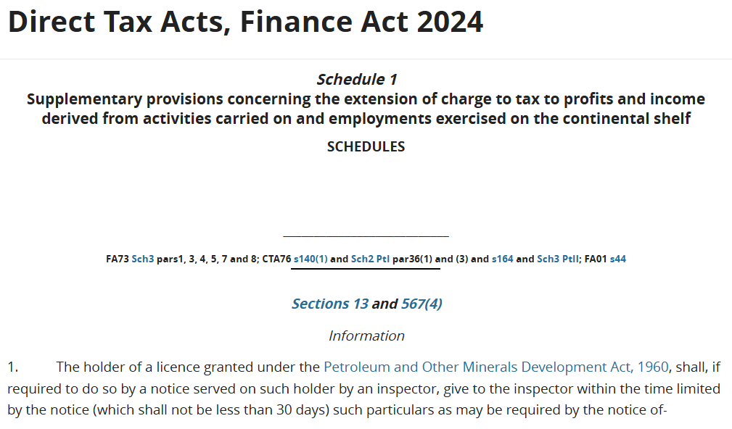
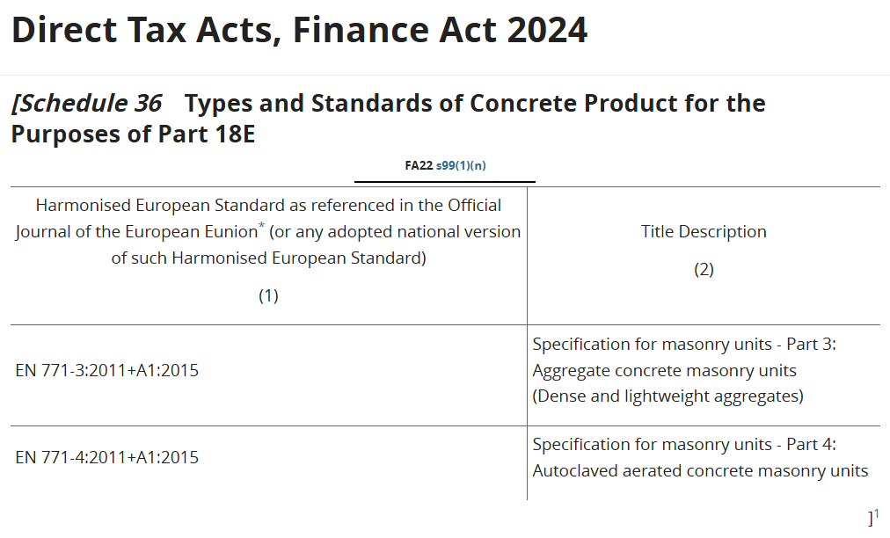
Schedule 1 to Schedule 36
‘Schedules’ 1-36, immediately follow Section 1104
These schedules are used to support or provide additional information with regard to different sections of the legislation. (Extract from Schedule 1 and Schedule 36 below)

Slide 7
Class Exercise – Schedules 4A & 13
1) Go to Schedule 4A
The table in Schedule 4A provides a list of the allowable classes of technology and the minimum spend as regards the provisions for claiming accelerated capital allowances for energy efficient equipment.
Identify the section of the legislation to which this schedule & table refers
2) Go to Schedule 13 which provides a list of all persons who are accountable persons for the purposes of the Professional Services Withholding Tax (PSWT) legislation
Find ‘The Revenue Commissioners’ & ‘Uisce Éireann’
Notes:
Number 12 is the Revenue commissioners.
If time permits mention other bodies like the National Roads Authority at 68.
Uisce Eireann is listed at 210 and Coimisiún na Meán, talk about the use of square brackets and superscript numbers

Slide 8
The ‘Contents’ List
The ‘Contents’ list provides a list of all sources of information contained within the TCA. Page numbers for the content’s list are Roman Numerals
The ‘Contents’ list includes:
  Provisional Collection of Taxes Act 1927
  Waiver of Certain Tax, Interest and Penalties Act 1993
  Interpretation Act 2005
  Finance (Tax Appeals) Act 2015
  Emergency Measures in the Public Interest (Covid Act) 2020
  Taxes Consolidation Act 1997
  Schedules
  Regulations

Slide 9
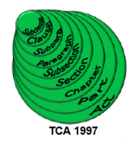
Taxes Consolidation Act 1997 (TCA)
The Taxes Consolidation Act contains:
Part 1 to Part 49 of the TCA 1997
Each Part may contain ‘Chapters’
Each Part and Chapter will contain ‘Sections’ of the legislation
Sections of the legislation may contain ‘Subsections’
Subsections may contain ‘Paragraphs’ and ‘Subparagraphs’
Subparagraphs may contain ‘Clauses’ and ‘Subclauses’

Slide 10
‘Contents’ List - Taxes Consolidation Act-
Part 1 Interpretation
TCA 1997, Part 1, Section 1 to Section 11 deals with ‘Interpretation’ including interpretation of certain words and phrases within the ‘TCA 1997’, the ‘Tax Acts’, the ‘Corporation Tax Acts, the ‘Capital Gains Tax Act’
Section 10 provides the interpretation for ‘connected persons’

Slide 11
Class Exercise - Interpretation
Exercise:
Go to Section 10 for the definition of a ‘relative’ for the purposes of the Income Tax Act and the Capital Gains Tax Act

Slide 12
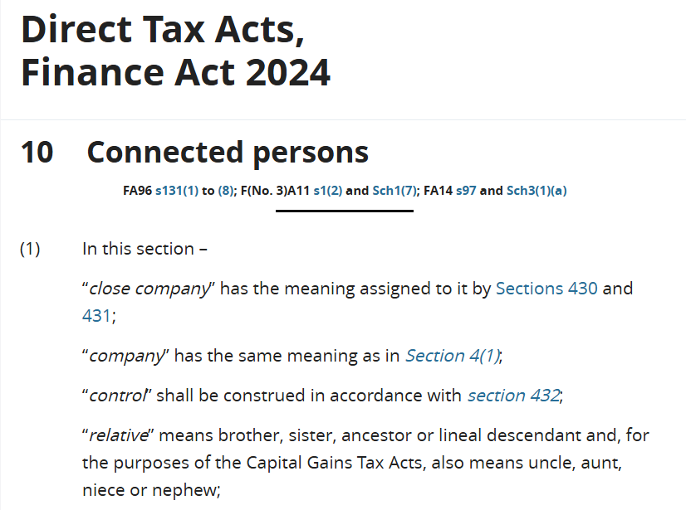

Solution- Definition of a ‘relative’ (TCA 1997)
Ancestor : one from whom a person is descended and who is usually more remote in the line of descent than a grandparent. (Merriam Webster online dictionary)
Lineal descendant: a person (a blood relative) who is in direct line to an ancestor, such as a child, grandchild, great-grandchild etc. (Law.com)
Notes:
A lineal descendant is distinguished from a collateral descendant, which would be from the line of a brother, sister, aunt or uncle.

Slide 13
Go To‘Contents’ List - Taxes Consolidation Act-
Part 2 - The Charge To Tax
PART 2: The Charge to Tax (under the Schedular System)
Chapter 1: Income Tax
The relevant Sections of legislation are shown on the left-hand side, and the associated page number is shown on the right. Specific Sections dealing with the ‘Schedular System of Taxation’ are as follows:
Schedule C: Section 17 (taxation of profits from public revenue dividends)
Schedule D: Section 18 (taxation of profits and gains from trade, profession, vocation)
Schedule E : Section 19 (taxation of income from an office, employment, pension)
Schedule F: Section 20 (taxation of dividends/ distributions from Irish resident companies

Slide 14
The ‘Schedular System’
The ‘Schedular System of Taxation’ under S18 TCA 1997 provides for the taxation of all types of income, which are grouped into different Schedules. Taxation of income under Schedule D is further divided into subgroups referred to as Cases as follows:
  Sch D Case I: Profits or gains from a trade
  Sch D Case II: Profits or gains from a profession or vocation
  Sch D Case III: e.g. foreign investment income, foreign rents, interest paid on certain government securities and interest on which DIRT is not collected
  Sch D Case IV: Deposit interest subject to DIRT & Miscellaneous income
  Sch D Case V: Irish Rental Income

Slide 15
Class Exercise - The ‘Schedular System’
  Go to Section 18 TCA 1997
  Identify the Part & Chapter of the TCA 1997 which contains the provisions for Section 18
  Identify the subsection, paragraph and subparagraph which states that tax under Schedule D Case I ‘shall be a charged’ on profits or gains arising from mining ‘pyrites’
  Note: Section18 subsection 1 (S18 (1))TCA 1997 provides for the charge to tax on ‘world-wide’ income on Irish resident individuals

Slide 16
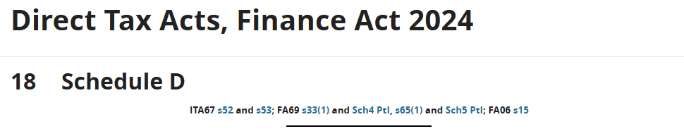
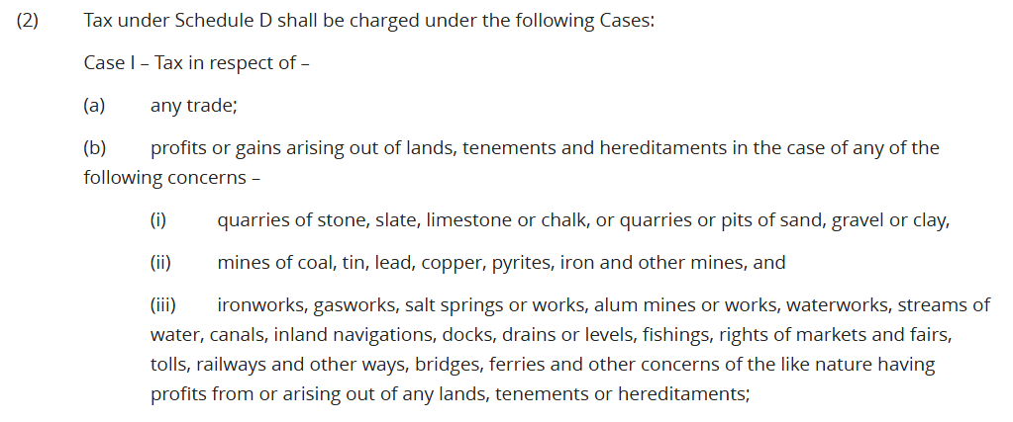
Solution – Extract from Direct Taxes Act

Slide 17
Regulations - Statutory Instruments (S.I.)
The ‘Contents’ includes a list of ‘Regulations’ (incl. the relevant pages, in the Direct Taxes Act, on which these regulations can be seen)
Ministerial orders known as Statutory Instruments provide detailed rules known as Regulations for implementing the Tax Acts (primary legislation)
Each Statutory Instrument is allocated a number and year

Slide 18
Class Exercise - Statutory Instruments (S.I.)
Go to the ‘Regulations’ page in the ‘Contents’
Find the Statutory Instrument listed for Relevant Contracts Tax
State the number and year of the S.I.
Go to the pages containing the S.I.

Slide 19
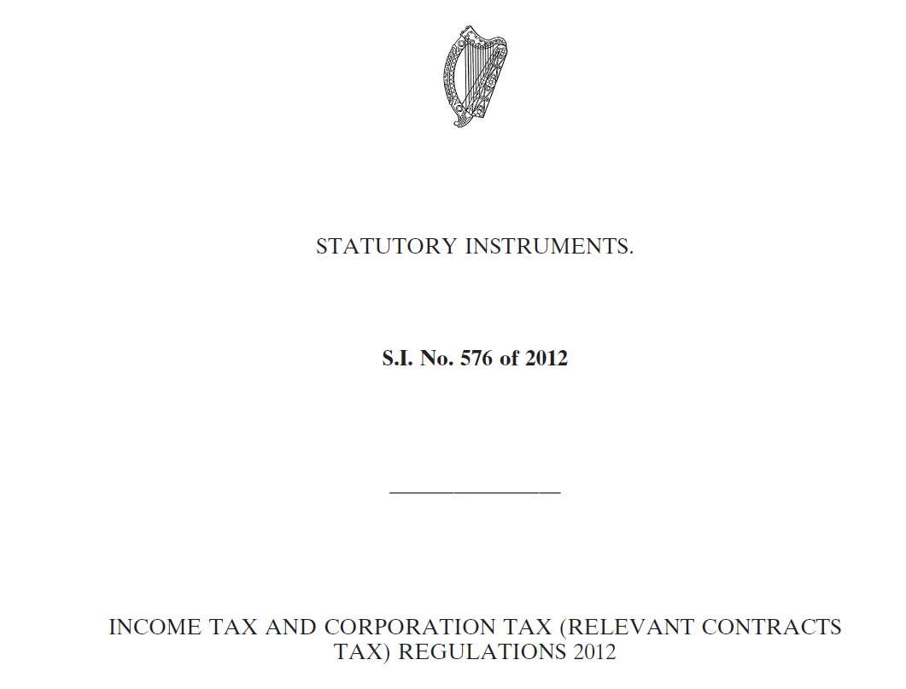

Statutory Instrument (S.I. No. 576 of 2012)

Slide 20
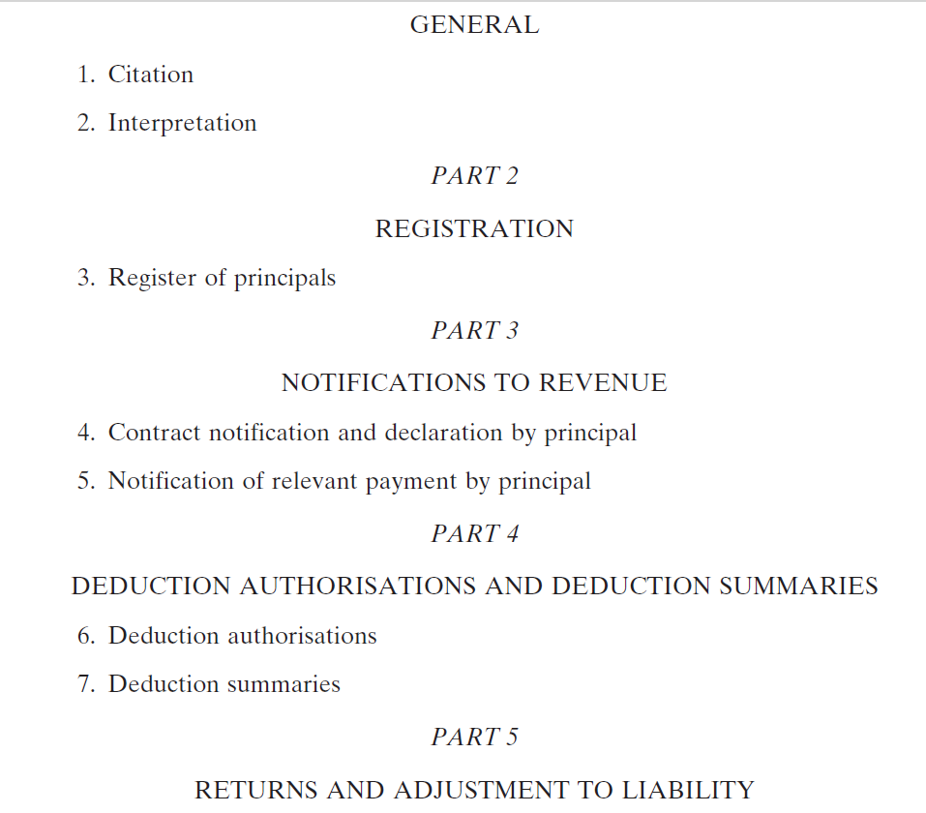
Statutory Instrument (S.I. No. 576 of 2012)

Slide 21
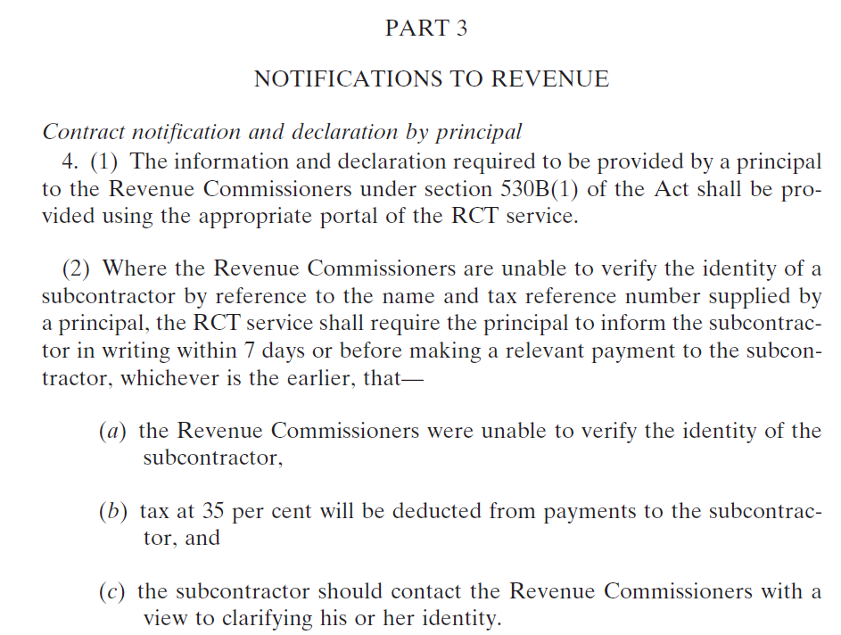
Statutory Instrument (S.I. No. 576 of 2012)

Slide 22
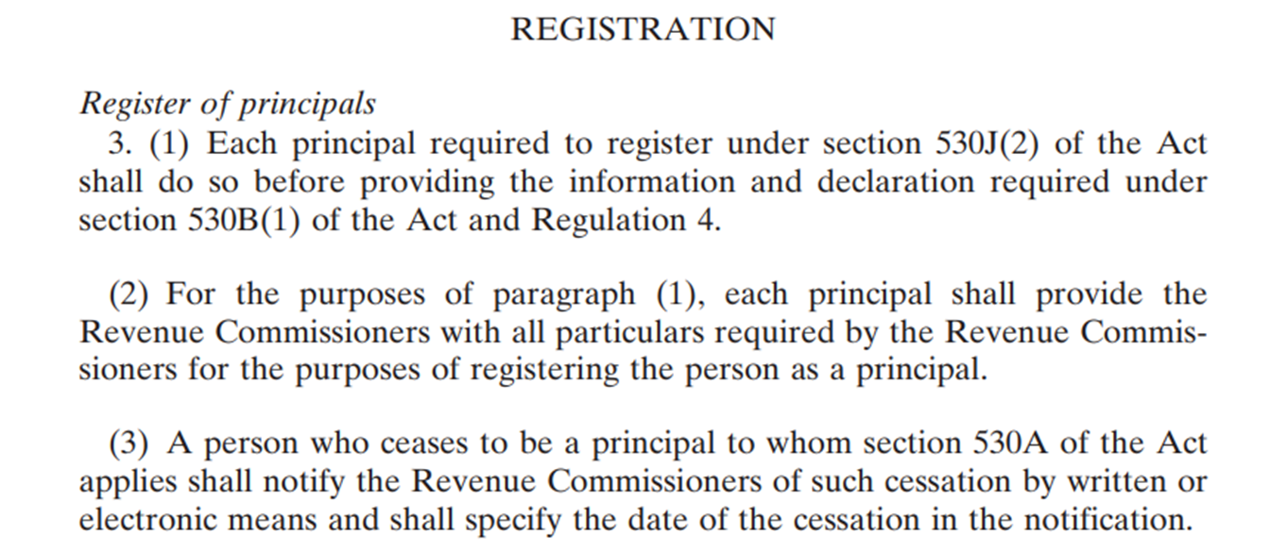
Statutory Instrument (S.I. No. 576 of 2012)
Note: These Regulations replace S.I. 761 of 2004 which stated that the Principal was required to register as a Principal within 21 days of entering a relevant contract with a subcontractor

Slide 23
Go To ‘Contents’ – Final Item Listed - The Index
Index- Alphabetical Order:
The final item listed in ‘Contents’ at the beginning of the book states the page on which the ‘index’ at the back of the book starts.
The index shows each relevant Section of the legislation and each relevant Schedule from Schedule 1 to Schedule 36, relating to each topic, sub-topic etc.

Slide 24
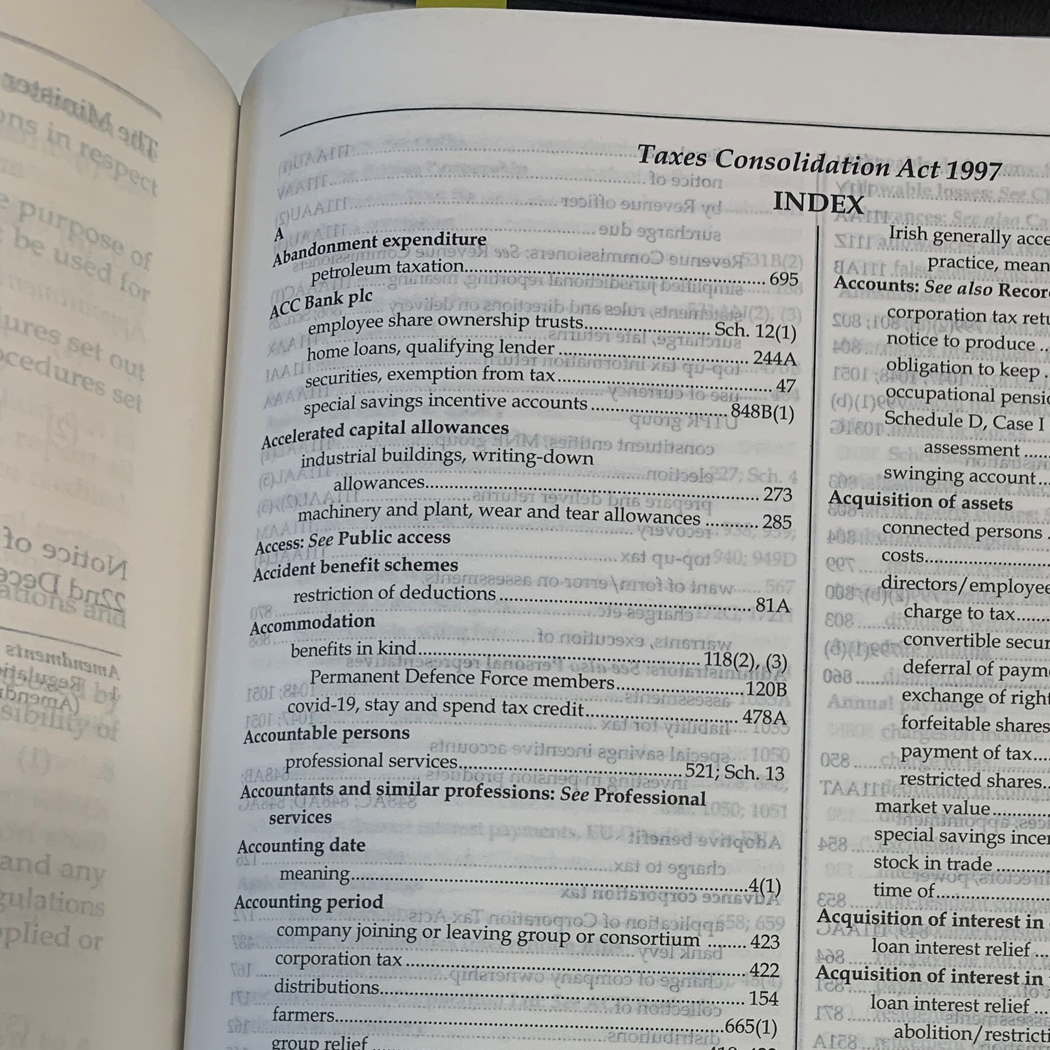
Go To the Index
In this photo of the TCA index we can see that ‘accountable persons’ are provided for in S521 and Schedule 13

Slide 25
Class Exercise- Index
Go to the Index:
Find:
The section of the legislation which contains the provisions for ‘The Residence of Individuals’ and the relevant residency tests and
The section of the legislation which contains the provisions for ‘Split Year Residence’

Slide 26
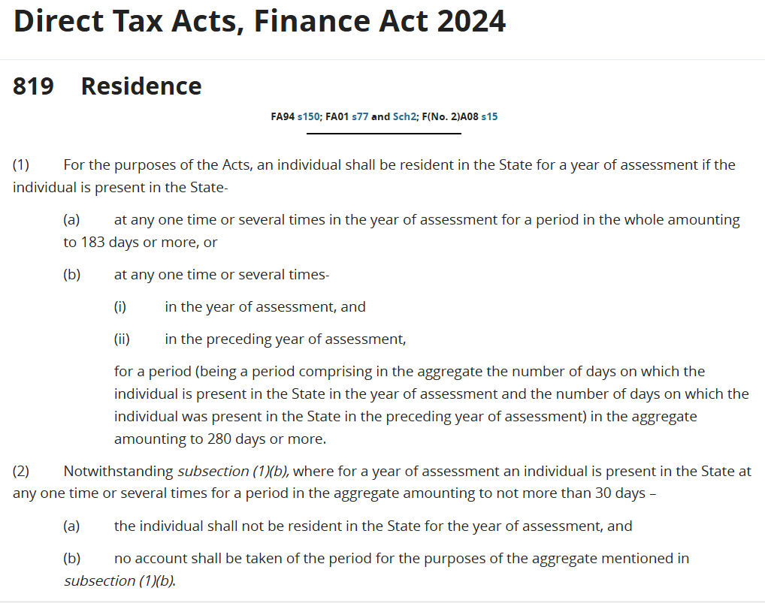

Solution – Extract from Direct Taxes Act
Notes:
Part 34 S819

Slide 27
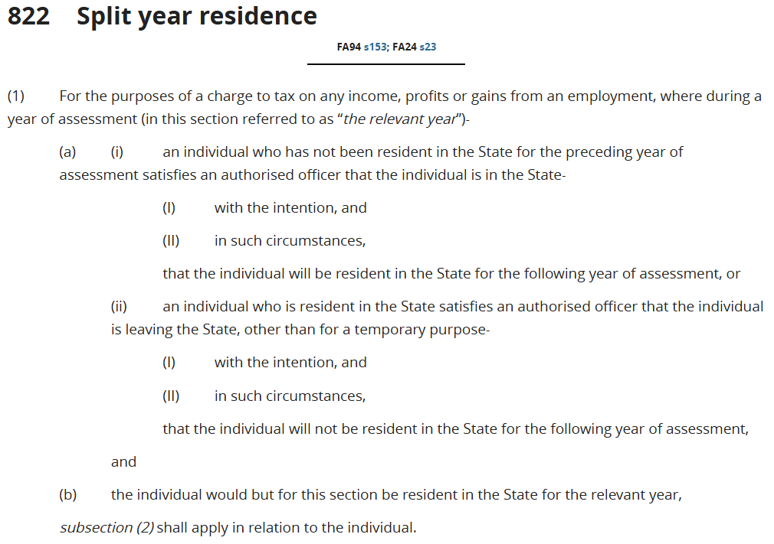
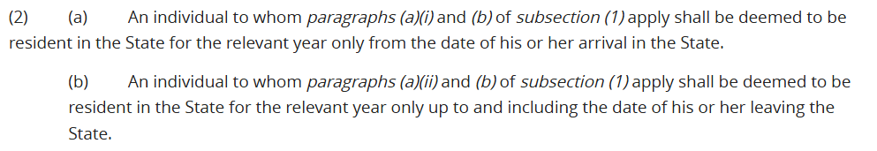
Solution – Extract from Direct Taxes Act cont’d

Slide 28
Go To the Table of Cases - Case Law Listing
Table of Cases (Case Law)
‘Contents’ list is immediately followed by an alphabetical list of Case law, stating the case reference and the relevant section/s of the legislation to which the case relates
Many cases are UK cases which are relevant in Irish Courts
Caseworkers should note that subsequent determinations made in Irish courts may differ from a previous decision in a UK case (e.g. tax treatment of food delivery drivers in the State (Karshan/Domino’s Pizza Case 2023, employees not self-employed)
Relevant case law will also be listed at the end of the section of the legislation together with ‘amendments’ to the section, Revenue precedents, Tax Appeal Determinations, Revenue guidance etc.
Look up the Table of Cases for the Karshan Case (relevant to S112 Sch E charge)
Check for a case which is relevant to S81 (General rules as to deductions)

Slide 29
Class Exercise – Case Law
Go to Section 81 TCA 1997 ‘General Rules as to Deductions’ to identify suggested case law relating to the non-deductibility of the following:
The cost of clothing and
The costs of professional fees incurred in relation to criminal proceedings were ‘wholly and exclusively laid out for the purposes of the trade

Slide 30
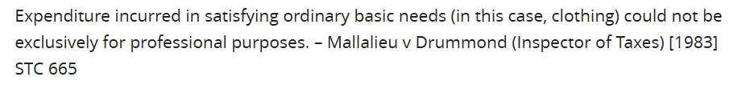
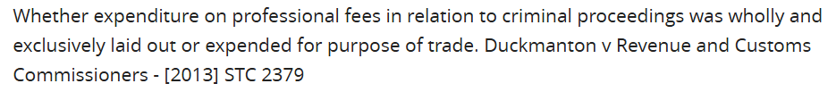
Solution- Extracts from Direct Taxes Act S81
General Rules as to Deductions

Slide 31
Parts & Chapters of the TCA 1997
For each section of the legislation, the heading at the top of the page shows the ‘Part’ and if applicable the ‘Chapter’ within that Part
e.g. Part 4 Chapter 3 provides for the following as regards the normal basis of assessment, the special rules for commencement and cessation of a trade, profession or vocation and short-lived business relief:
The ‘Normal’ Basis of Assessment under Case I/II of Schedule D (S65)
The ‘Special’ basis at Commencement of a trade or profession (S66)
The ‘Special’ basis on Discontinuance of a trade or profession (S67)
‘Short-lived’ business relief (commencement & cessation within 3 years (S68)

Slide 32
Part 7 – Chapter 1- Exemptions
Part 7 deals with Income Tax and Corporation Tax Exemptions, Chapter 1 of Part 7 deals specifically with the Income Tax exemptions
e.g. Rent-a-Room relief provides an income tax exemption as regards certain rental income received: S216A Subsection (1) includes the definitions required for that specific section i.e. qualifying residence, relevant sums, residential premises
Subsection (2) contains the main purpose of the legislation i.e. Rent-a-room Relief
Subsection (3) includes a caveat, where the relief will not apply e.g. if the taxpayer elects not to claim the relief
Subsections (4) – (8) contain other relevant information such as the requirement to file a tax return despite the fact that qualifying rental income under the Rent-a-Room scheme being exempt from Tax, USC & PRSI (216A (4))

Slide 33
Class Exercise – S216A Definition
Go to Section 216A Rent – a – Room Relief : Find the following:
The definition of a ‘qualifying residence’ for the purpose of claiming Rent-a-Room relief and
The definition of ‘relevant sums’ for the purpose of claiming Rent-a-Room relief

Slide 34
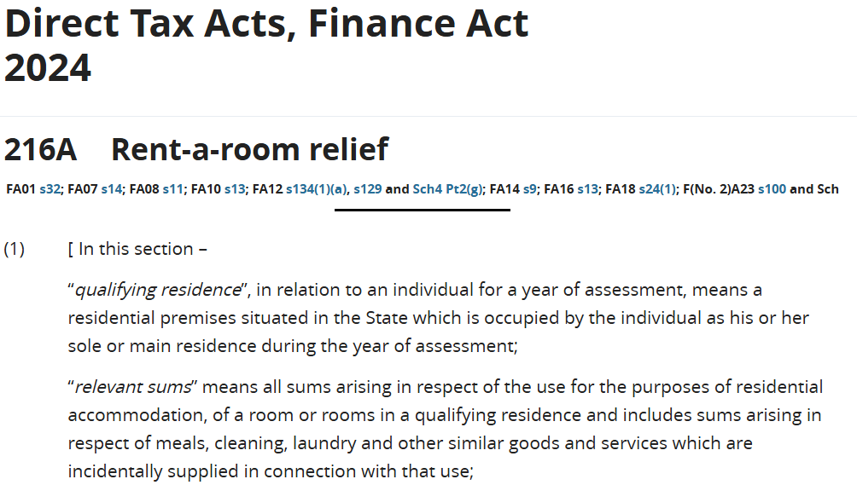
Solution – Extract from Direct Taxes Act

Slide 35
Class Exercise – Rent -a-Room
Exemption Threshold
S216A - Find the following:
The current threshold for claiming Rent-a-Room relief and
The date from which the current threshold came into force

Slide 36
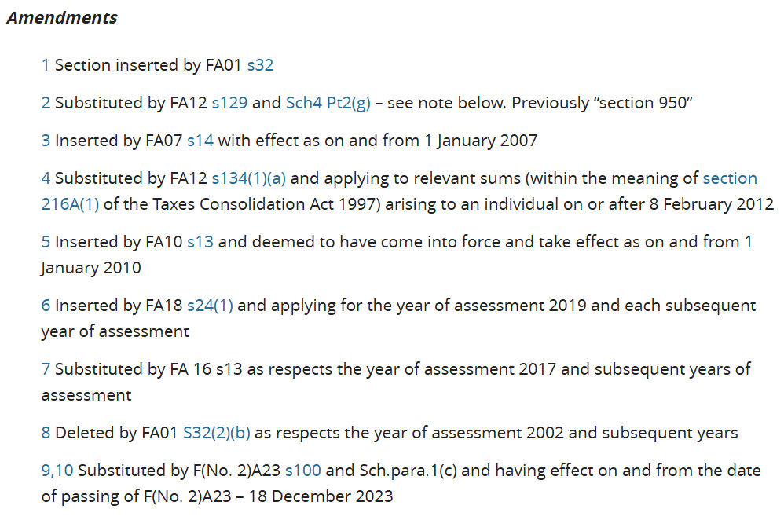
Solution – Extract from Direct Taxes Act

Slide 37
‘Literal’ Rule of Statutory Interpretation
The ‘Literal’ or primary rule of interpretation:
Apply the ordinary and natural meaning of the words used
Consult a dictionary to determine the meaning of words which have no particular legal meaning
If a provision is aimed at a particular trade, business or transaction, words should be construed as having the meaning that they have in the context of that trade, business or transaction

Slide 38
‘Purposive’ Rule of Interpretation
The purposive rule of interpretation is a legal principle where courts look beyond the literal words of a statute to understand and apply the law according to the intended purpose or goal of the legislature, especially if the text is ambiguous:
In this case, caseworkers should:
Read the piece of legislation as a whole (including the long and short titles, schedules, definition and interpretation sections, etc) and
Apply the plain intention of the Oireachtas where it is clear, based on the context of the provision within the Act as a whole
Note : The legislative history of the section may also be considered in determining the original intention of the Oireachtas (RLS may be able to assist with this via RTS)

Slide 39
Use of Certain Words in the Acts
The Direct Taxes Acts contain many specific definitions throughout
Use of words in the legislation such as ‘State’, ‘notwithstanding’, ‘shall,’ ‘may’, ‘means,’ ‘includes’, ‘deemed’, ‘subject to’, ‘and’, ‘or’ is common and their meaning is important
The State: The Republic of Ireland and its territorial waters (Ireland’s territorial waters extend 12 nautical miles or 22km from its coast, encompassing airspace, seabed and waters, but full maritime jurisdiction stretches further)
Notwithstanding: Means ‘despite what has been said in an earlier part of the section or in another section of the legislation …..’

Slide 40
Use of Certain Words in the Acts
Shall: A person has a duty to do something
e.g. S216A (4) ‘The provisions of the Income Tax Acts relating to the making of returns shall apply as if this section had not been enacted’ (Despite the exemption from tax, USC & PRSI for income which qualifies for Rent-a-Room relief a Return of Income must be filed)
May: Is used where a power, permission, benefit or privilege given to a person may, but need not be exercised e.g. An individual may claim Rent-a-room relief under S216A but while they may be entitled to claim the relief they may not wish to do so (it may be more beneficial to include the income with other rental income and claim all available deductions instead)

Slide 41
Use of Certain Words in the Acts
Means: This word is used to define something specific, e.g. In S216A subsection (1) ‘residential premises’ means ‘a building or part of a building used as a dwelling’.
Includes: Where the word ‘means’ is replaced with the word ‘includes’ we will see some examples of where the legislation applies but the section does not define all possibilities.
e.g., Section 3 subsection (1) defines the word ‘Trade’ as follows; the word ‘trade’ includes every trade, manufacture, adventure or concern in the nature of a trade’ (this is a broad definition as it would not be possible to be more specific)

Slide 42
Use of Certain Words in the Acts
Deemed: Is used where reality is temporarily suspended, e.g. an RCT return is deemed to have been filed if no amendments are made by the taxpayer by the specified return date
Subject to: The section or paragraph may be governed by another part of the legislation
e.g. S216A (5) states ‘subject to subsection (7), the rent limit of an individual referred to in subsection (2) is [€14,000] ⁷ ’. Subsection (7) states that the threshold will be divided between multiple individuals in respect of ‘relevant sums’ from a ‘qualifying residence’
Note: The threshold of €14,000 in square brackets indicates that the figure has been amended by the Finance Act in the past. The superscript number ⁷ brings you to a note at the end of S216A which states the date from which the new threshold of €14,000 applies

Slide 43
Use of Certain Words in the Acts
The use of the word ‘and’ at the end of a sentence means that all items listed, such as conditions required to qualify for a relief, must be satisfied
On the other hand, if the word ‘or’ is used at the end of the condition, this indicates that one of two or more of those conditions may be required for relief to apply but not ALL conditions
If the second last condition ends with the word ‘or’ then if any one of the conditions is satisfied the person may be entitled to the relief, unless another section of the legislation provides for an exclusion

Slide 44
Class Exercise- Farming
Go to S667B ‘New arrangements for qualifying farmers’
Check the definition of a ‘qualifying farmer’ under
Subsection (1) paragraph (a) and
Subsection (1) paragraph (b)

Slide 45
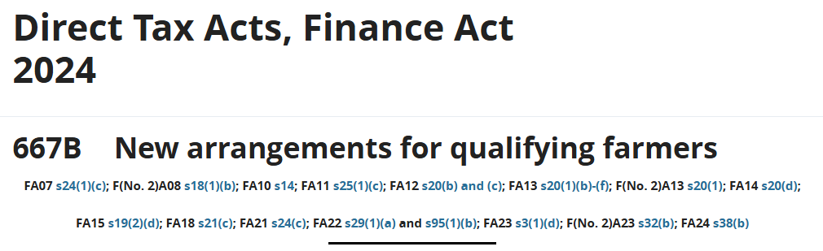
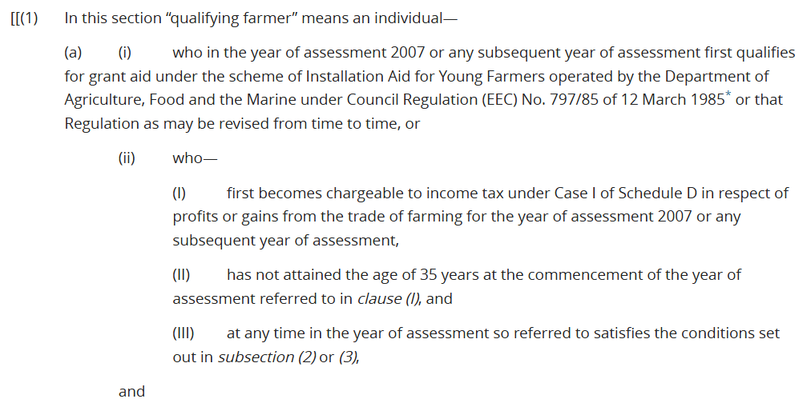
Extract from the Direct Taxes Act

Slide 46
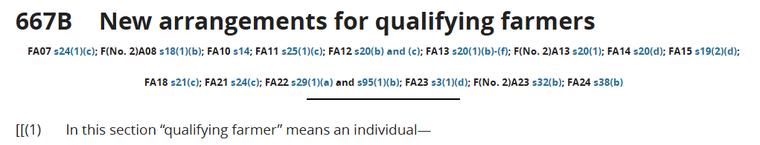
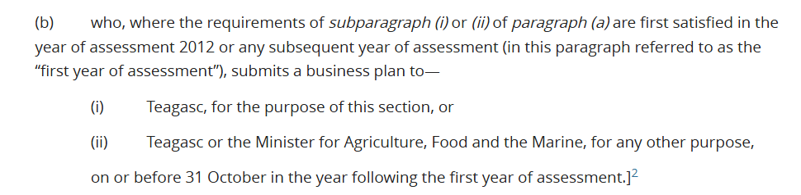
Extract from the Direct Taxes Act

Slide 47
See Workbook 1
Quiz Questions on Legislation
Quiz 1

Slide 48
Recap Unit 1.1
Residence, Ordinary Residence and Domicile

Slide 49
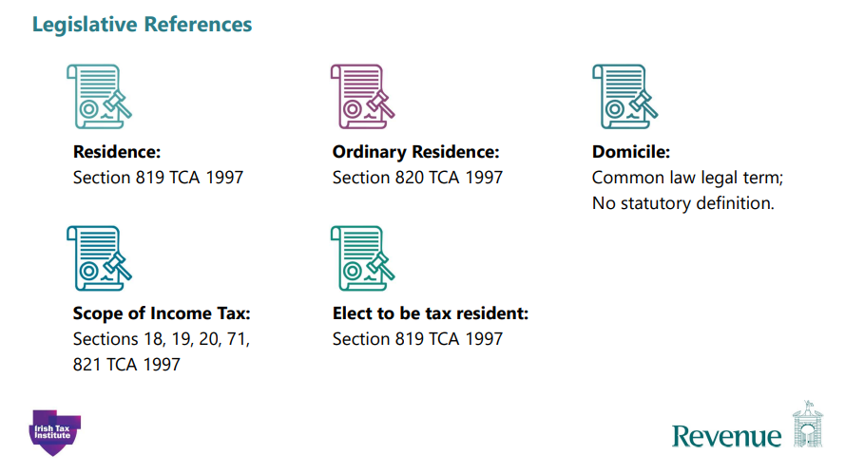
Notes:
S18 Schedule D, S19 Schedule E, S20 Schedule F, S71 foreign securities and possessions, S821 provides for the application of sections 17 (Schedule C income) and S18 (1) where tax is charged under Schedule D on profits or gains arising to certain residents of the State and certain persons who are not resident in the State

Slide 50
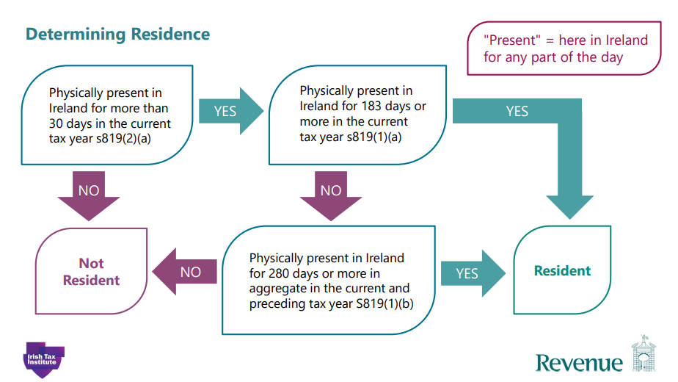
RTB note: Ireland = Republic of Ireland, the State
Must be resident for more than 30 days in
each year for the purposes of this test

Slide 51
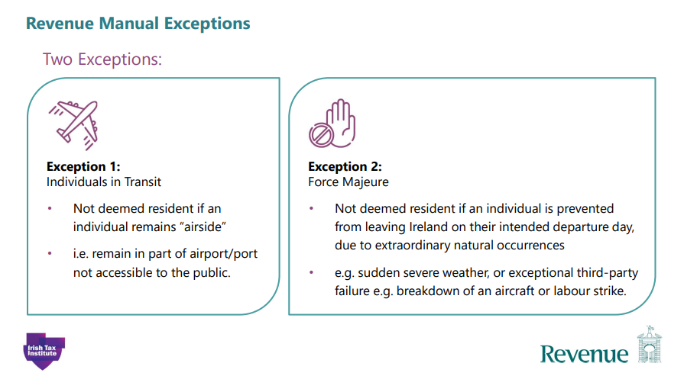
RTB Note: ‘Airside’ is the restricted part of an airport including areas in the terminals past security checkpoints (opposite is ‘landside’, e.g. parking & check in)

Slide 52
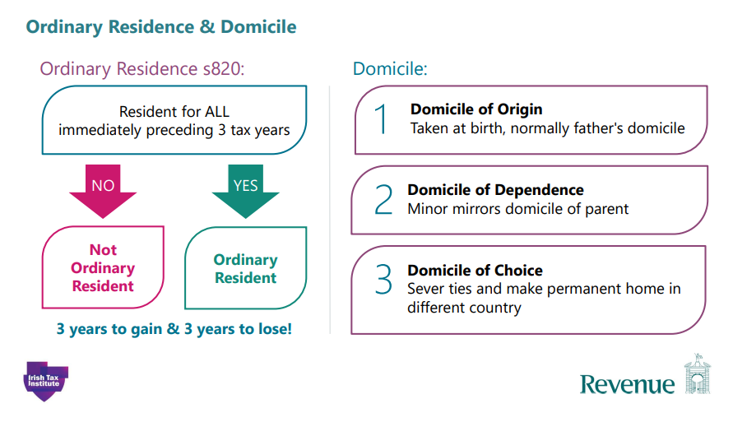

Slide 53
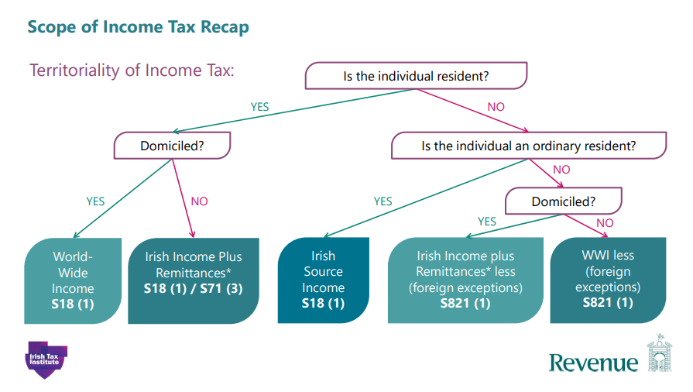
RTB note: S71 (3) provides for *Remittances
Notes:
S18 Schedule D charge to tax, S 71 (3) deals with the charge to tax on remittances brought into the State.

Slide 54
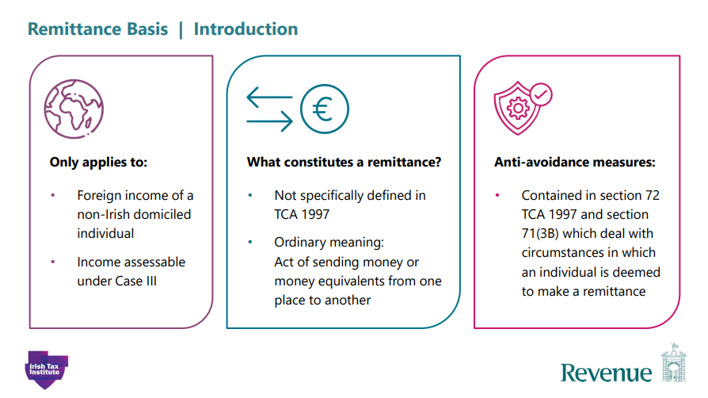
RTB Note: S72 provides for ‘loans’ repaid out of foreign income
Notes:
S72 – Charge to tax on sums applied outside the State in repaying certain loans.
Look up ‘loans’ in the index, scroll to ‘repayment out of foreign income’ and S72 is shown, other anti-avoidance provisions are dealt with in S813 but are not covered here

Slide 55
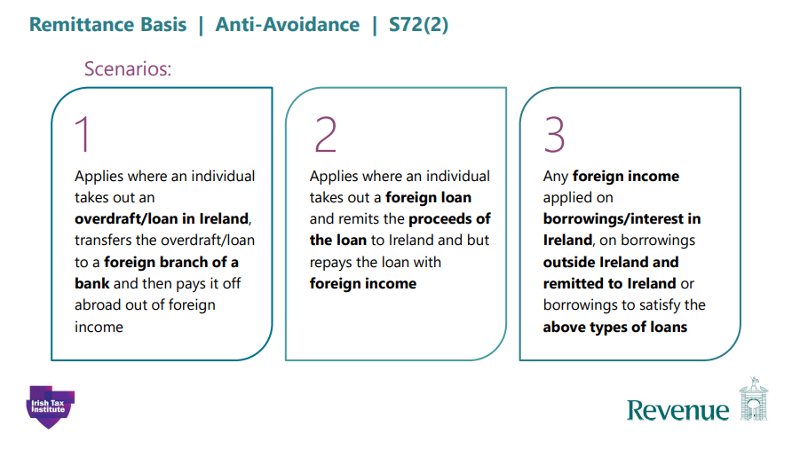

Slide 56
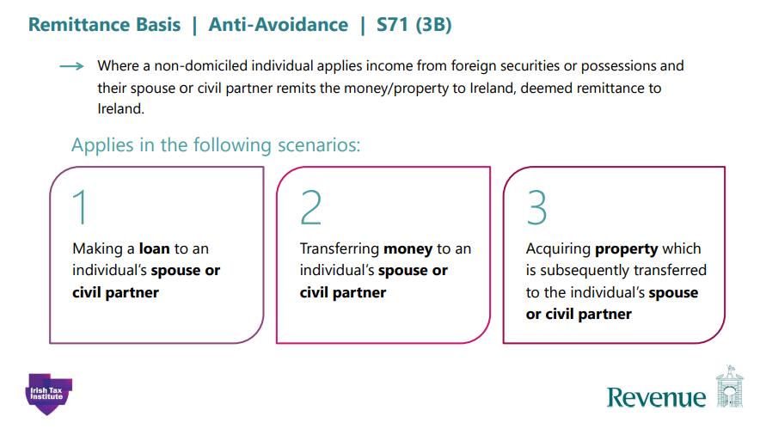

Slide 57
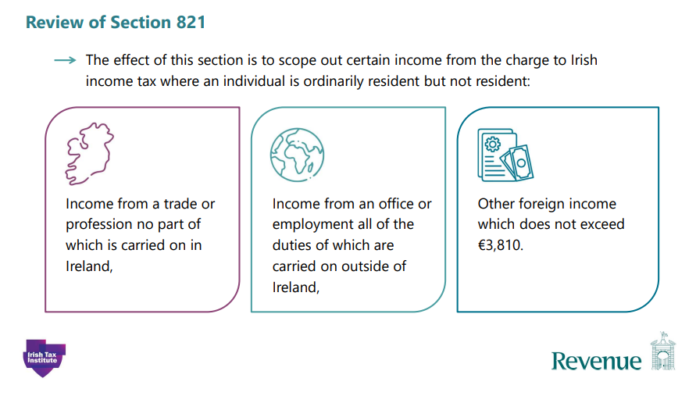
RTB note: In the circumstances stated above, i.e. ordinarily resident but not resident, these sources of income are not taxable in Ireland (the State)

Slide 58
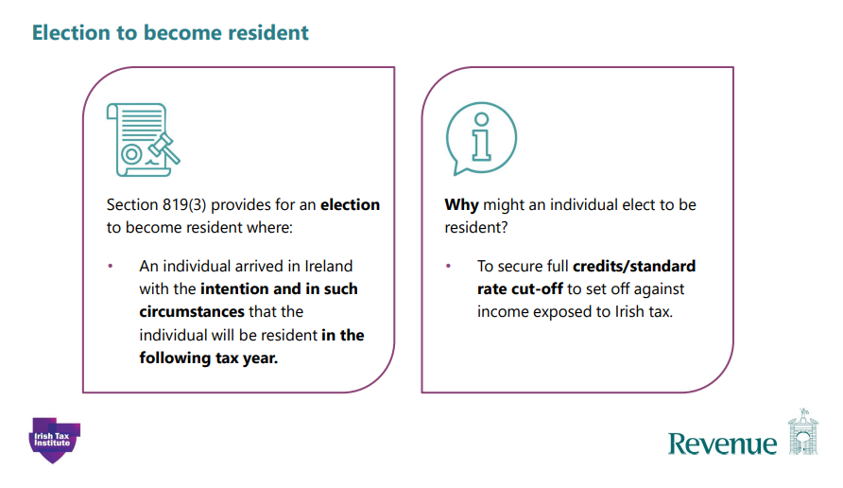

Slide 59
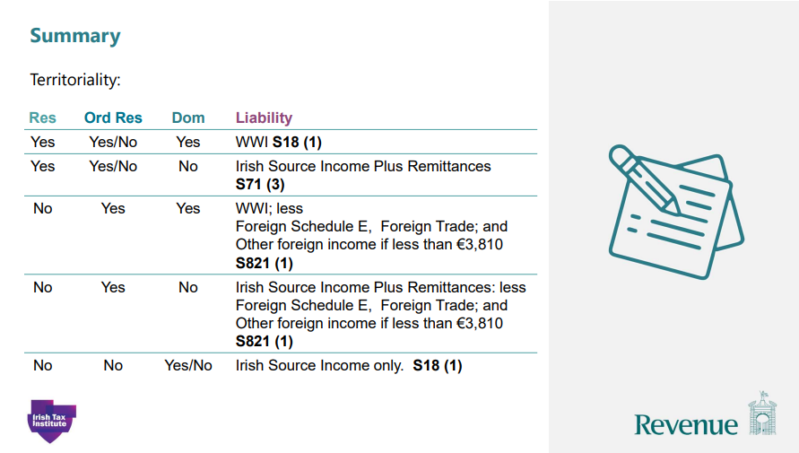
RTB Note: WWI = World-wide Income
RTB Note: S821 wording as follows: Does not exceed €3,810 as opposed to saying ‘is less than’

Slide 60
 | Resident | Ordinarily Resident | Domiciled | Income Assessable in State
 | Yes | Yes | Yes | Worldwide Income
 | Yes | No | Yes | Worldwide Income
 | Yes | No | No | Irish Income and Foreign Income Remitted
 | Yes | Yes | No | Irish Income and Foreign Income Remitted
 | No | No | No | Irish sourced Income and Income from a Trade, Profession or Employment exercised in the State
 | No | No | Yes | Irish sourced Income and Income from a Trade, Profession or Employment exercised in the State
 | No | Yes | No | Irish sourced income & Foreign Income Remitted with Exemptions: Income from Trade / Profession; Office or Employment, the duties of which are exercised outside the State Other Foreign Income not in excess of €3,810
 | No | Yes | Yes | Worldwide income with Exemptions: Income from Trade / Profession; Office or Employment, the duties of which are exercised outside the State Other Foreign Income not in excess of €3,810

Slide 61
See Workbook 1
for
Residence Quiz 2

Slide 62
ATTENDANCE: Please scan QR Code, complete form using exact course code below and submit
TT2008
1st Oct 2026

Slide 63
Recap Unit 1.2
The Schedular System

Slide 64
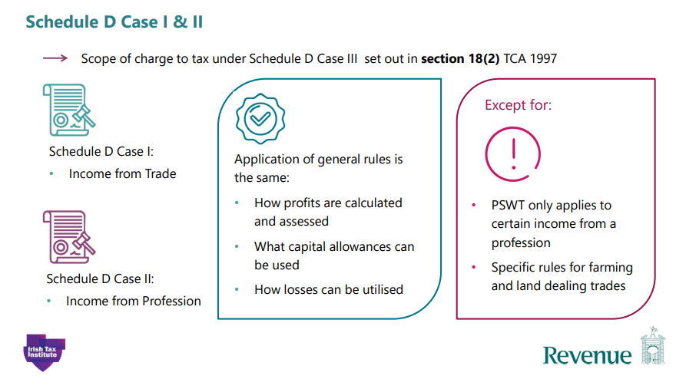

Slide 65
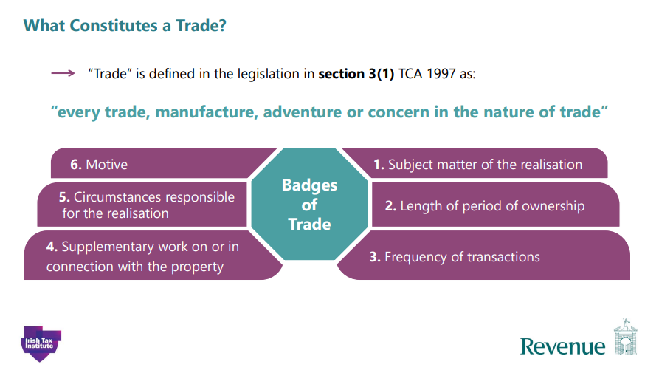

Slide 66
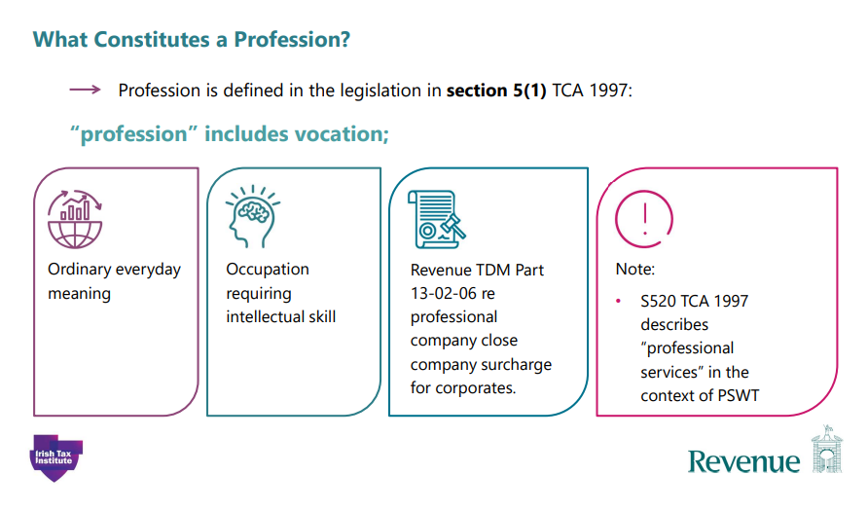

Slide 67
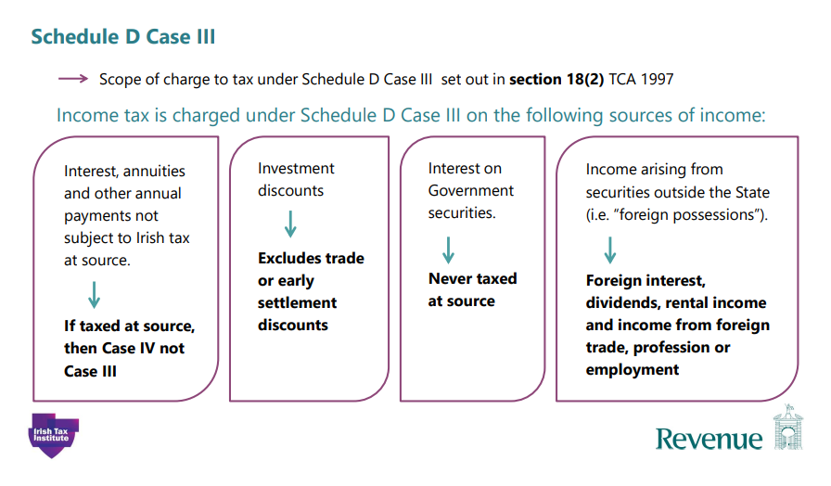
Notes:
Some online bank accounts do not collect tax on the interest at source i.e. DIRT and it has to be declared by the T/P such interest would be Case III not Case IV

Slide 68
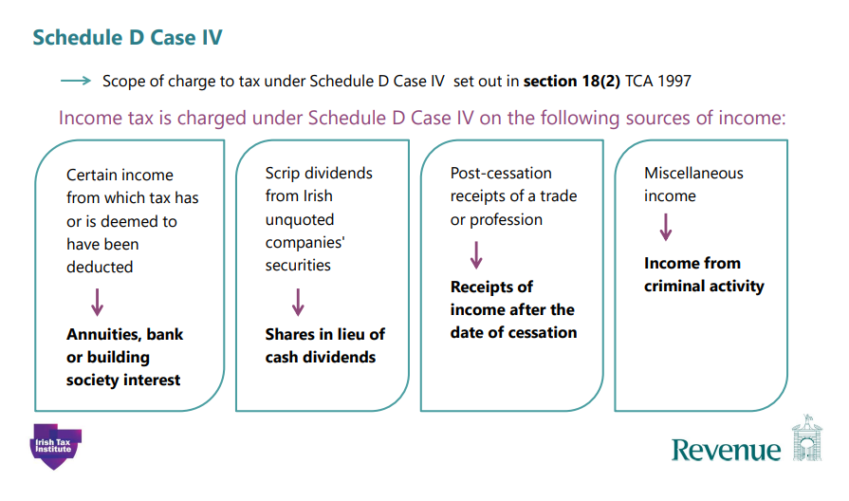

Slide 69
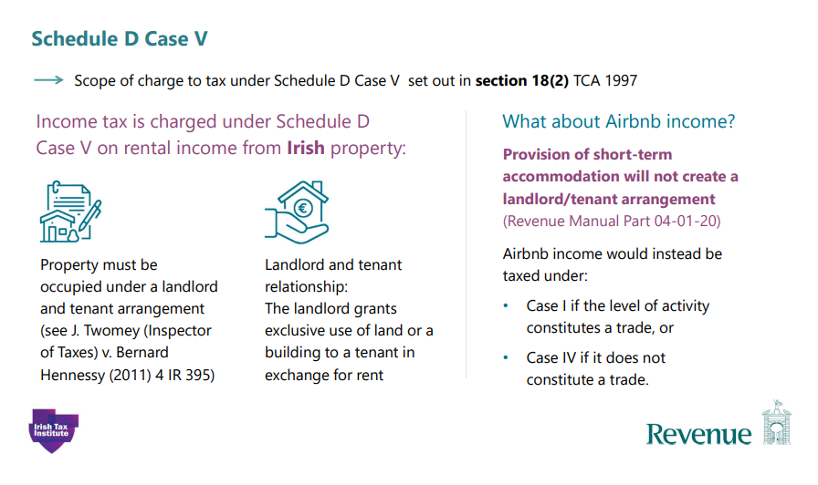

Slide 70
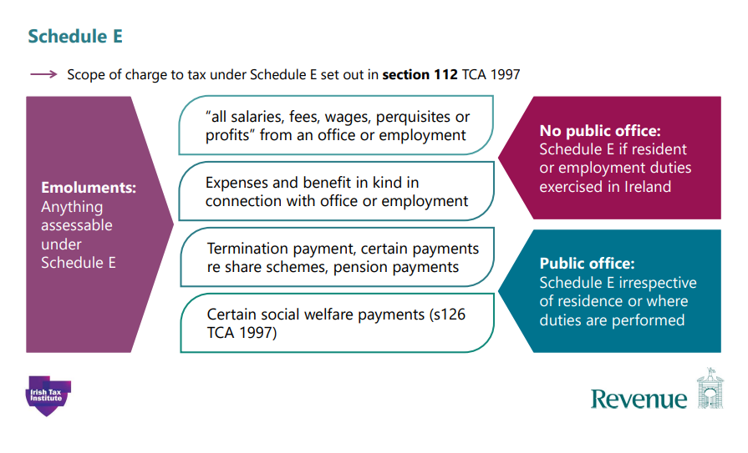

Slide 71
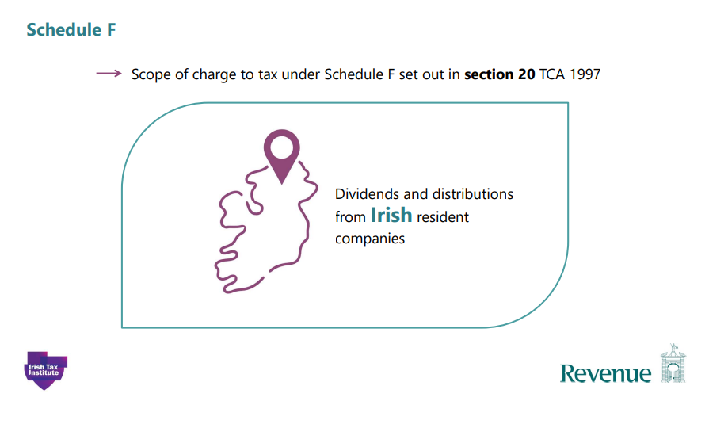

Slide 72
See Workbook 1
For Schedular System
Quiz 3

Slide 73
Recap Unit 1.3
Schedule D Case I & II
Computation for an Individual

Slide 74
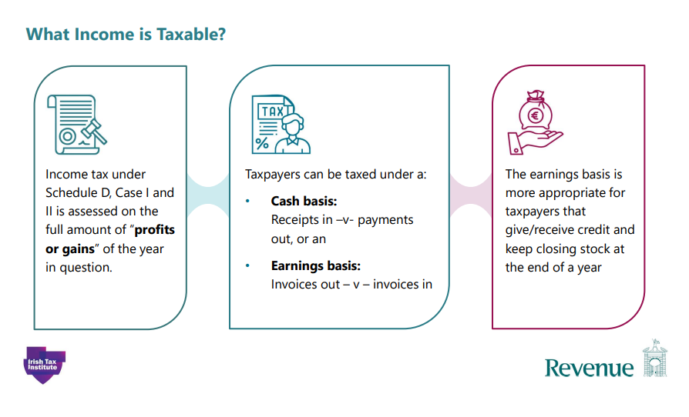

Slide 75
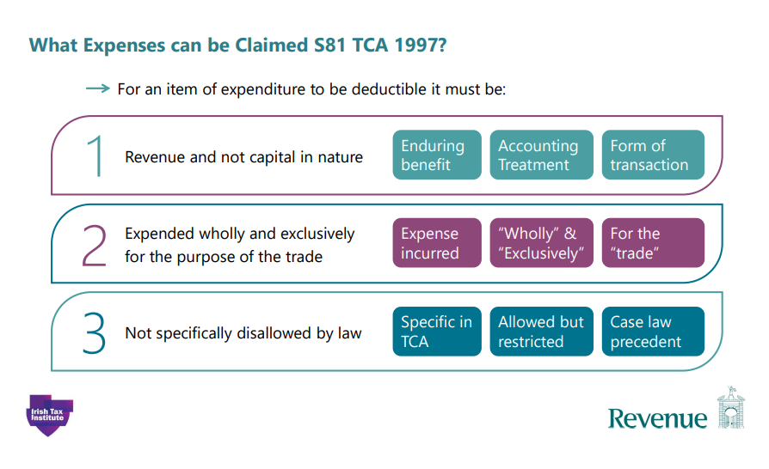

Slide 76
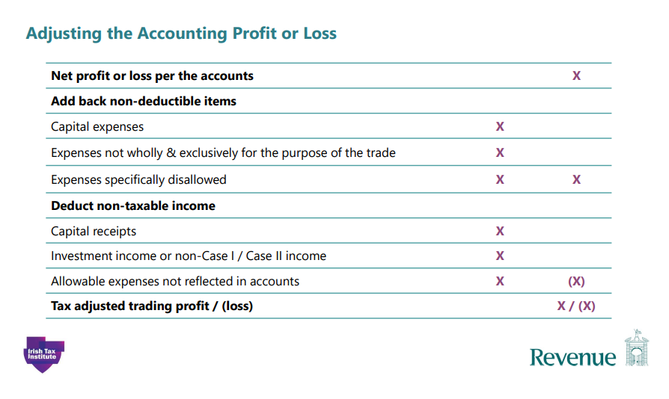
RTB note: Case I/II tax adjusted profit
RTB note e.g. cost of assets
RTB note: Misleading heading, possibly should say non-trading income
e.g. bank loan or profit from sale of an asset
e.g. Trade capital allowances

Slide 77
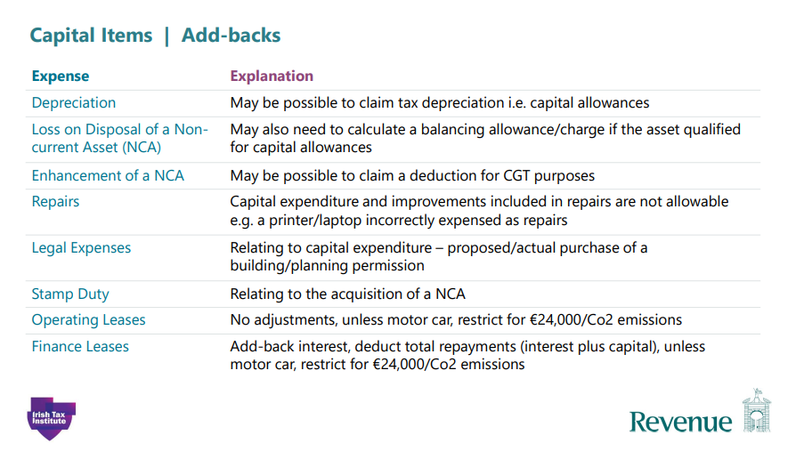

Slide 78
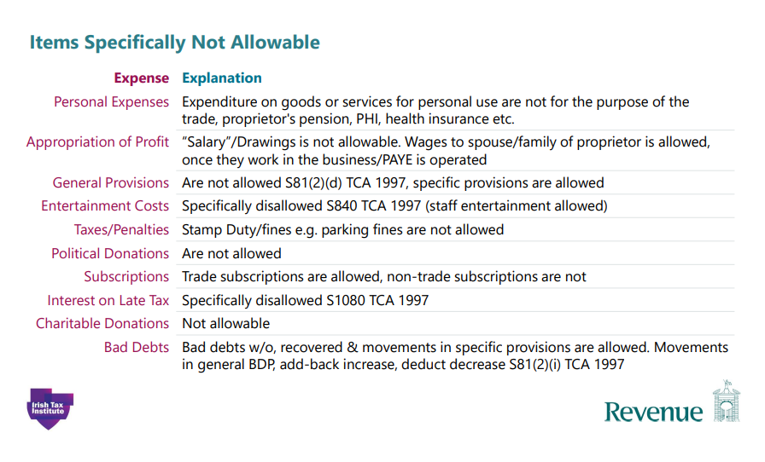

Slide 79
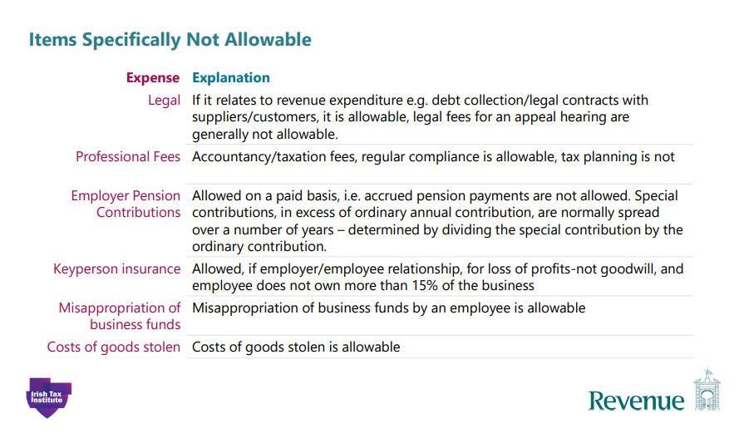

Slide 80
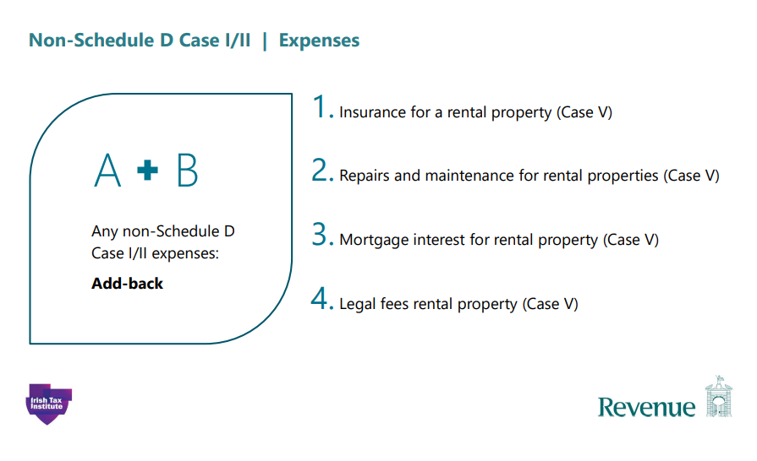

Slide 81
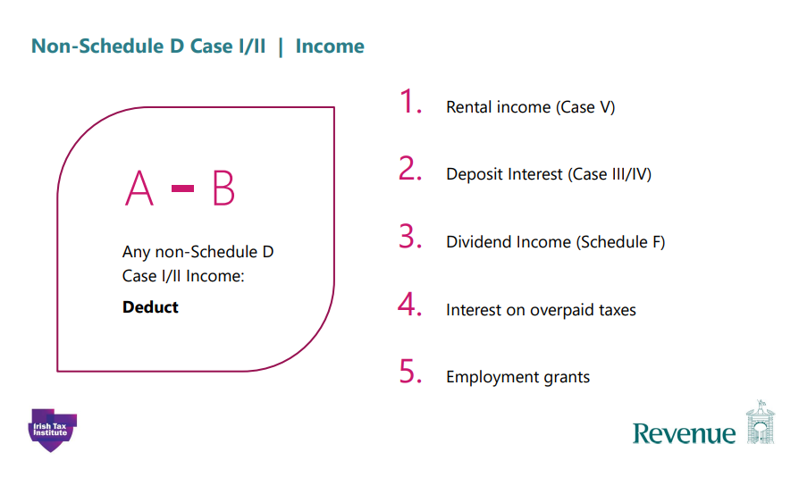

Slide 82
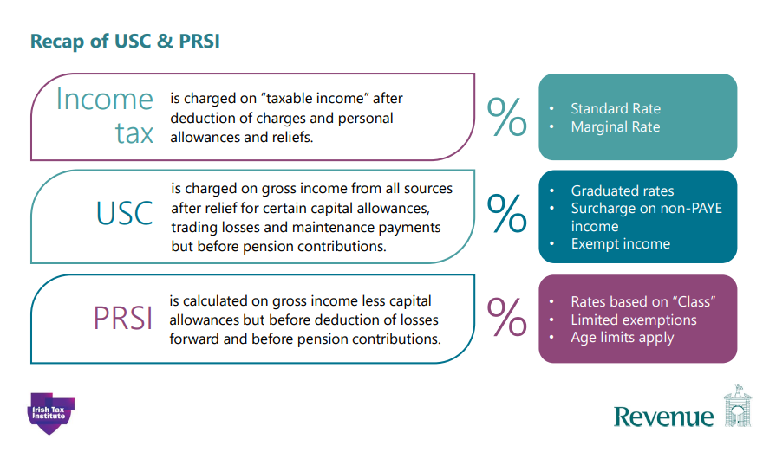

Slide 83
See Workbook 1 for
Quiz number 4
Addbacks

Slide 84



Basis of Assessment for Case I/II
Commencement, Cessation & Change of Accounting Date
of a Trade or Profession
(Unit 1.4)
Notes:
The basis of assessment for an ongoing trade and for the Commencement & Cessation of a Trade or Profession under Schedule D Cases 1 and 2 is provided for in sections 65, 66 and 67 of the taxes consolidation act 1997.

Slide 85
Learning Objectives
Basis of Assessment rules for the taxation of profits arising for sole traders including:
    Normal Basis of Assessment - S65 (2) (a) TCA 1997
    Commencement of a trade – S66 TCA 1997
    Cessation of a trade - S67 TCA 1997
    Change of accounting date S65 (2) (b) & S65 (3) TCA 1997

Slide 86
What Profits or Gains are taxable in a year of Assessment (Case I/II)
The ‘full amount of profits or gains’ is taxed in each year of assessment.
Legislation does not define the phrase ‘full amount of profits or gains’
The difference between the income and the allowable expenditure of the business will produce either a profit or a loss and this amount will determine the income tax liability for the year of assessment

Slide 87
Normal Basis of Assessment
Sole traders in business for a number of years normally prepare a 12-month set of accounts when computing the profit (or loss) applicable for a tax year.
That set of accounts can end on any date within the tax year. (NOTE: All other income e.g. Rents, dividends etc. are taxed on a calendar year basis
This 12-month period is referred to as the ‘basis period’
Note: The tax year and the tax return (F11 self-employed or F12 PAYE employee ) always relate to the period 1 Jan to 31 Dec however, the 12-month basis period generally aligns with the 12-month accounting period used by the business, which may not be a calendar year
Notes:
Sole traders in business for a number of years normally prepare a 12-month set of accounts when computing the profit (or loss) applicable for a tax year. That set of accounts can end on any date within the tax year.
This 12-month period is referred to as the ‘basis period’ for tax purposes.
Note: The tax year and the tax return (F11 for self-employed or F12 for PAYE employees) always relate to the period 1 Jan to 31 Dec however, the 12-month basis period generally aligns with the 12-month accounting period used by the business, which may not be a calendar year.

Slide 88
Normal Basis of Assessment of Profit - Question
Accounts (for 12-month period) | Tax Adjusted Profit for 12 months | Tax Year Assessable
Rob: Year ended 31 December 2026 (Basis period - 01/01/2026 to 31/12/2026) (12 Months) | €35,268 | ?
Sarah: Year ended 30 June 2026 (Basis period - 01/07/2025 to 30/06/2026) (12 Months) | €46,749 | ?
Notes:
See question as per slide

Slide 89
Normal Basis of Assessment of Profit - Solution
Accounts (for 12-month period) | Tax Adjusted Profit for 12 months | Year Assessable
Rob: Year ended 31 December 2026 (Basis period - 01/01/2026 to 31/12/2026) (12 Months) | €35,268 | 2026
Sarah: Year ended 30 June 2026 (Basis period - 01/07/2025 to 30/06/2026) (12 Months) | €46,749 | 2026
Notes:
See solution as per slide

Slide 90

Commencing to Trade - 1st Year of Trading
Year 1: The business commences trading
The tax assessment for the first year of trading is based on profits arising from the date of commencement of the business to 31 December of that year
This period, referred to as the basis period, is imposed by legislation in the first year of trading, the profit (or loss) will relate to the ‘actual’ or ‘calendar’ months of trading up to 31 December.
Notes:
Year 1: The business commences trading
The tax assessment for the first year of trading is based on any profits arising from the date of commencement of the business to 31 December of that year
This period, referred to as the basis period, is imposed by legislation in the first year of trading, the profit (or loss) will relate to the ‘actual’ or ‘calendar’ months of trading up to 31 Dec. A set of accounts may need to be time apportioned to identify the assessable profit or loss for the first year of assessment.

Slide 91

Scenario 1- One 12-month set of Accounts
On 1 Oct 2024, Jack commenced trading as a lumberjack his first 12-month set of accounts for the period 1 Oct 2024 to 30 Sept 2025 is a €26,000 profit
The €26,000 profit does not relate to the calendar year 2024 or 2025, it spans two tax years but relates to a 12-month period starting in Oct 2024 and ending in Sept 2025
Jack’s second 12-month set of accounts shows a smaller profit of €16,000 from 1 Oct 2025 to 30 Sept 2026 (Note: this profit is charged to tax in 2026 i.e. Jack’s third year in business)
Notes:
On 1 Oct 2024, Jack commenced trading as a lumberjack his first 12-month set of accounts for the period 1 Oct 2024 to 30 Sept 2025 is a €26,000 profit
The €26,000 profit does not relate to the calendar year 2024 or 2025, it spans two tax years but relates to a 12-month period starting in Oct 2024 and ending in Sept 2025
Jack’s second 12-month set of accounts shows a reduced profit of €16,000 from 1 Oct 2025 to 30 Sept 2026

Slide 92
Example cont’d: Assessable Profit in Year 1
Year 1 - 2024:
Jack’s ‘Basis period’ in his first year starts on the date his business commenced to trade and ends on 31Dec in the same tax year, e.g. 1 Oct 2024 to 31 Dec 2024 hence Jack’s 12-month profit of €26,000 must be apportioned so that he can return 3 month’s profit on his Form 11 for 2024
€26,000 x 3/12 = €6,500 taxable profit 2024 (Oct, Nov & Dec)
Note: The same €26,000 will also be used when Jack is returning his 12-month profit on his 2025 Form 11 but he may be able to claim relief in year 3 referred to as ‘second year excess’
Notes:
Year 1 - 2024:
Jack’s ‘Basis period’ in his first year starts on the date his business commenced to trade and ends on 31Dec in the same tax year, e.g. 1 Oct 2024 to 31 Dec 2024 hence Jack’s 12-month profit of €26,000 must be apportioned so that he can return 3 month’s profit on his Form 11 for 2024
€16,000 x 3/12 = €4,000 taxable profit 2024 (Oct, Nov & Dec)
Note: The same €26,000 will also be used when Jack is returning his 12-month profit on his 2025 Form 11 but he may be able to claim relief in year 3 referred to as ‘second year excess’

Slide 93
Example cont’d: 2nd Year of Trading
Year 2 - 2025:
Jack’s first ‘set of accounts’ was prepared for a period of 12-months from the commencement of the trade to 30 Sept 2025
Jack’s tax assessment for 2025 (TAX YEAR 2) is based on the full €26,000 profits reported in that first 12-month set of accounts ending on 30 Sept 2026
Note: Legislation does not require Jack to submit accounts on a calendar year basis
Notes:
Year 2 - 2025:
Jack’s first ‘set of accounts’ was prepared for a period of 12-months from the commencement of the trade to 30 Sept 2025
Jack’s tax assessment for 2025 (TAX YEAR 2) is based on the full €26,000 profits reported in that first 12-month set of accounts
Note: Legislation does not require Jack to submit accounts on a calendar year basis

Slide 94
Example cont’d
Year 2: 2025 Computation:
Jack’s profit for the 12-month period ending on 30 Sept 2025 is €26,000 as per the accounts submitted, the assessable profit for 2025 is as follows:
€26,000 x 12mths = €26,000 is the assessable profit for 2025
12mths
The full €26,000 is assessed in 2025 despite the fact that the accounts period ends on the 30th Sept 2025 (Note: any profit arising in the remaining months in 2025 will be taxed in the year 2026)
Notes:
Year 2: 2025 Computation:
Jack’s profit for the 12-month period ending on 30 Sept 2025 is €26,000 as per the accounts submitted, the assessable profit for 2025 is as follows:
€26,000 X 12mths/ 12 mths = €26,000 is the assessable profit for 2025
The full €26,000 is assessed in 2025 despite the fact that the accounts period ends on the 30th Sept 2025

Slide 95
Example cont’d
Year 3: 2026 is the ‘second year excess’ available in year 3?
If Jack had been assessed on a calendar year basis in 2025 his assessable profit may have been lower, if his accounts for Year 3 show a lower profit than in year 2 Jack should review Year 2 on a calendar year basis before he completes his tax return for Year 3
Jack’s profit for the 12-months ending on 30 Sept 2026 has reduced to €16,000 as per the accounts submitted, the assessable profit is reduced by the second year excess as follows:
Notes:
Year 3: 2026 is the ‘second year excess’ available?
Jack’s profit for the 12-months ending on 30 Sept 2026 has reduced to €16,000 as per the accounts submitted, the assessable profit is as follows:
If Jack had been assessed on a calendar year basis in 2025 his assessable profit may have been lower, he will now review year 2 on a calendar year basis before he completes his tax return for year 3

Slide 96
Example cont’d
Year 2: 2025 Original Assessment was €26,000
‘Calendar Year’ review of 2025
€26,000 x 9mths = €19,500 Jan 2025 to Sept 2025
12mths
€16,000 x 3mths = € 4,000 Oct, Nov & Dec 2025
12mths €23,500 (€23,500)
Second Year Excess € 2,500
Jack’s assessable profit of €16,000 for Year 3 (2026) can be reduced to €13,500 by offsetting the second year excess of €2,500
Notes:
Year 3: 2025 Original Assessment was €26,000
‘Calendar Year’ review of 2025
€26,000 X 9mths/ 12 mths = €19,500 Jan 2025 to Sept 2025
€16,000 X 3mths/ 12 mths = € 4,000 Oct, Nov & Dec 2025
€23,500 €23,500
Second Year Excess € 2,500
Jack’s assessable profit of €16,000 for Year 3 can be reduced to €13,500 by offsetting the second year excess of €2,500

Slide 97
Insufficient Profits to Absorb 2nd Year Excess
If the profit for Year 3 is less than the 2nd Year excess OR
If the taxpayer has a trade loss in Year 3
then the unutilised 2nd Year excess can be carried forward and used as a S382 LOSS for offset against the next available profits from the SAME TRADE ONLY

Slide 98
Example
Using a 2nd Year excess of €4,000 and assuming the profit for Year 3 was only €2,000, the computation is as follows:
Profit for Year 3 €2,000
Less 2nd Year Excess (€4,000)
Assessment for year 3 NIL
Unutilised 2nd Year Excess (€2,000)
Note: The assessment for Year 3 will be reduced to NIL for the trade
The unutilised 2nd Year Excess of (€2,000) is carried forward into Year 4 for
offset (if possible) against any available trade profits (same trade only)

Slide 99
Commencing to Trade: Scenario 2
Other than the years of commencement and cessation of a trade, an individual can only be assessed on the profits arising in a 12-month period ending on the end date of the accounts submitted for the tax year
On occasion a set of accounts may show a profit for a period exceeding 12-months
e.g. first day of trading is 1 Nov 2025 and first set of accounts covers the period 1 Nov 2025 to 31 Dec 2026 i.e. 14 months (to facilitate change of accounting date)
Notes:
Apart from the years of commencement and cessation of a trade, an individual can only be assessed on the profits arising in a 12-month period ending on the end date of the accounts submitted for the tax year
On occasion a set of accounts may show a profit for a period exceeding 12-months
e.g. first day of trading is 1 Nov 2025 and first set of accounts covers the period 1 Nov 2025 to 31 Dec 2026 i.e. 14 months (to facilitate change of accounting date)

Slide 100

Example
Serena commenced trading as a tennis instructor on 1 Sept 2024
Her accounts showed the following profits:
14 months from 1 Sept 2024 to 31 Oct 2025 Profit €128,000
12 months from 1 Nov 2025 to 31 Oct 2026 Profit € 86,000
Notes:
Serena commenced trading as a tennis instructor on 1 Sept 2024
Her accounts showed the following profits:
14 months from 1 Sept 2024 to 31 Oct 2025 Profit €128,000
12 months from 1 Nov 2025 to 31 Oct 2026 Profit € 86,000

Slide 101
Example Cont’d
Year 1- 2024
Serena’s first year in business her profit is extracted from €128,000
‘Basis Period’ – 1 Sept 2024 to 31 Dec 2024
Time apportioned to 4 months in the first year
€128,000 x 4/14 ( four fourteenths) = €36,571 assessable profit 2024
Notes:
Year 1- 2024
Serena’s first year in business her profit is extracted from €128,000
‘Basis Period’ – 1 Sept 2024 to 31 Dec 2024
Time apportioned to 4 months in the first year
€128,000 x 4/14 (4 fourteenths) = €36,571 assessable profit 2024

Slide 102
Example cont’d
Year 2 - 2025
Serena’s second year in business
‘Basis period’- 1 Nov 2024 to 31 Oct 2025 (12 months) Profit €128,000
€128,000 x 12/14 (twelve fourteenths) = €109,714 assessable profit for 2025
Note: The same set of accounts is used to extract the assessable profit for both year 1 and year 2
Notes:
Year 2 - 2025
Serena’s second year in business
‘Basis period’- 1 Nov 2024 to 31 Oct 2025 (12 months) Profit €128,000
€128,000 x 12/14 (12 fourteenths) = €109,714 assessable profit for 2025
Note: The same set of accounts are used to extract the assessable profit for both year 1 and year 2

Slide 103
Question
Compute Serena’s second year excess
and her assessable profit for 2027
Notes:
See question as per slide

Slide 104
SOLUTION
Accounts - 1 Sept 2024 to 31 Oct 2025 (14 mths) profit €128,000
Accounts - 1 Nov 2025 to 31 Oct 2026 (12 months) profit € 86,000
______________________________________________________________________________
Original assessment for 2025 €109,714
Calendar Year Review of 2025 i.e. profits for Jan to Dec
€128,000 x 10/14 = € 91,429 (Jan to Oct 2025)
€ 86,000 x 2/12 = € 14,333 (Nov & Dec 2025)
€ 105,762 €105,762
Second Year Excess € 3,952
Serena’s profit for year 3 of €86,000 can be reduced by €3,952
Her final assessable profit for 2026 is €82,048
Notes:
See solution as per slide

Slide 105
Ceasing to Trade: Taxing the Final Profits
The final year’s assessment is based on profits arising in the calendar months of that FINAL year i.e. from 1 January to the date the business has ceased to trade AND
A ‘penultimate year’ review (second last year) is carried out to compute the profit for that year as if the person had been on a calendar year basis
Note: If the calendar year profit is higher then the penultimate year assessment will be increased to collect additional taxes, if the calendar year profit is lower then the original assessment stands
Notes:
The final year’s assessment is based on profits arising in the calendar months of that year i.e. from 1 January to the date the business has ceased to trade AND a ‘penultimate year’ review is carried out to compute the profit for that year on a calendar year basis.
Note: If the calendar year profit is higher then the penultimate year assessment will be increased to collect additional taxes, if the calendar year profit is lower then the original assessment stands for the penultimate year.

Slide 106
Final Year
David ceased trading as a wildlife photographer on 31 March 2026, his final 12-month set of accounts showed the following profit:
Profit for Year Ending 31 March 2026 €24,000
Final Year 2026 profit computed as follows:
€24,000 x 3mths = assessable profit for 2026 € 6,000
12mths
Notes:
David ceased trading as a wildlife photographer on 31 March 2026, his final 12-month set of accounts showed the following profit:
Profit for Year Ending 31 March 2026 €24,000
Final Year 2026 profit computed as follows:
€24,000 X 3mths/ 12 mths = € 6,000

Slide 107

QUESTION
Alfred ceased trading as a film maker on 30 June 2026
His final set of accounts showed the following:
Profit for year 1 July 2025 to 30 June 2026 €22,000
Required:
Compute Alfred’s assessable profit for 2026
Notes:
See question as per slide

Slide 108
SOLUTION
Profit as per final 12 months trading as follows:
1 July 2025 to 30 June 2026 €22,000
Apportion to assess profit arising from 1 Jan 2026 to 30 Jun 2026
i.e. from 1 Jan in the final year to date of cessation of trading
€22,000 x 6 mths = €11,000 Assessable profit for final year of trading
12 mths
Notes:
See solution as per slide

Slide 109
Change in Accounting Date
ONGOING TRADE

Slide 110
Change in Accounting Date
A business changing its accounting date will lead to either:
  No accounting period of 12 months in the tax year, OR
  More than one accounting period in the year
Under self-assessment the taxpayer is obliged to carry out a prior year review and to notify Revenue of any additional taxes due (anti-avoidance rule)
(S65 (2) (b) & S65 (3) TCA 1997)
Note: The prior year review is NOT to compute ‘Actual’ profits it is to compute the taxable profit based on the new accounting period

Slide 111
Example: Change in Accounting Date
Pat has been trading for many years. His new accountant decided to change Pat’s accounting date from 30 June to 30 Sept from 2025 onwards, he sent in the following accounts:
12 months profit to 30 June 2024 €20,000
12 months profit to 30 June 2025 €25,000
3 months profit to 30 Sept 2025 € 5,000

Slide 112
Example continued
The 12-month profit for the tax year 2025 is computed as follows:
€5,000 X 3/3 = € 5,000 (Jul, Aug, Sept 2025)
€25,000 X 9/12 = €18,750 (Oct, Nov & Dec 2024 & Jan – Jun 2025)
€23,750 (12 months profit)
This is the year that the agent changed the accounting date to 30th of September and the computation above is the basis for assessing Pat on his profit for the 12-month period ending 30 Sept 2025

Slide 113
Example continued : Review Previous Year
Deemed basis period for 2024 : 1 Oct 2023 to 30 Sept 2024
Profit to 30 Jun 2024 : €20,000* (includes months Oct 2023 to Jun 2024) 9 mths
Profit to 30 Jun 2025 : €25,000 (includes months Jul 2024 to Sept 2025) 3 mths
The profit for the period in question is apportioned as follows:
€20,000 X 9/12 = €15,000
€25,000 X 3/12 = € 6,250
€21,250 is greater than €20,000*
Assessment for 2024 is increased to €21,250

Slide 114
Further Practice Questions on
Basis of Assessment
Commencement & Cessation of a Trade
in Workbook 1

Slide 115
Thank you

